Slide 1

Industrial Automation and Control (20EE11Q3)
Dr. Kavirayani Srikanth
Asst. Professor
Dept. of EEE

Slide 2
Course Objectives
CO1 Describe the architecture of industrial automation systems (L2)
CO2 Distinguish PID control tuning techniques (L3)
CO3 Explain time delay systems and special control structures and PLCs (L3)
CO4 Explain the working of flow control valves in hydraulic systems(L4)
CO5 Illustrate the working of Industrial Drives and Electrical Vehicle Drives (L4)

Slide 3
Unit-1 Syllabus
Introduction - Architecture of Industrial Automation Systems–Classification- Examples-Pharmaceutical Industries and Measurements, Food Processing Industry, Aerospace Industry, Bioprocess Industry, Paper & Textile Industry, Automation Pyramid
Measurement Systems :Characteristics –Semiconductor sensors, Smart Sensors, Microsensors, IR Radiation Sensors, Ultrasonic Sensors, Fibre Optic Sensors, Chemical Sensors, Biosensors, Data Acquisition Systems

Slide 4
Introduction
The Sensors are devices that responds to a physical stimulus heat, light, sound, pressure, magnetism, motion, etc , and convert that into an electrical signal.
They perform an input function
The Devices which perform an output function are generally called Actuators and are used to control. some external device, for example movement.
Transducers are devices used to convert energy of one kind into energy of another kind.

Slide 5
What is sensing?
Collect information about the world
Sensor - an electrical/mechanical/chemical device that maps an environmental attribute to a quantitative measurement
Each sensor is based on a transduction principle - conversion of energy from one form to another

Slide 6
Why sensors?
Industrial robot requires sensory feedback to:
Locate randomly placed object;
Allow for variations in shape of objects;
Protect against dangerous and unexpected situations. Especially if the robot must work close to humans:
Allow “intelligent” recovery form error conditions;
Perform quality control.
The main objective of incorporating sensors in robotic system is to enable robots to work in nonstructural and random environments.
Sensors will make robots more intelligent. But the associated robotic software must have the ability to receive data from the sensors and to process the necessary real time information and commands needed for the decision making.

Slide 7
Semiconductor Sensors
Silicon is the most favoured and largely utilized element with all its physical properties suited for development of smart sensors.
Semiconductor materials have been used for measurement of temperature, strain, etc.
For pressure measurements, the mechanical properties of silicon have been proved to be extremely suitable.

Slide 8
Sensors using semiconductor material and silicon
Energy Domain | Self Generating | Passive | Diode type | Transistor Type | Smart sensor
Radiation | Solar Cell | Photo Conductor | Photo Diode | Photo Transistor | Photo IC-CCD
Mechanical | - | Piezo resistors | Piezo junction diode | Piezo transistor | Accelerometers piezo ICs
Thermal(For Temp) | Thermocouple | Thermistor semiconductor resistor | Reverse biased diode | Forward biased transistor | Temperature IC
Electrical | - | Electrical field MOSFET | Electrical field MOSFET | Dual gate MOSFET | IC Chips for all
Magnetic | Induction coils | Magneto resistor | Magneto diode | Hall effect | Hall effect ICs
Chemical | Galvanic | Ion-Concentrator | -- | Ion selective FET | Electronic Nose

Slide 9
PN Junction diode
A typical PN junction diode is also used as a position sensor by making use of lateral photoeffect.
When a light spot illuminates a solar cell, an emf is developed across the ohmic contacts as a function of the light spot.
Using this effect, two-dimensional light spot sensitive photodiodes are fabricated.

Slide 10
Discussion
Making use of two matched transistor and effecting a difference between their emitter voltages due to the quantity under measurement has been a popular technique.
An integrated silicon flowmeter is designed on the samelines using matched pair of piezotransistors for flow measurements at temperatures between -40 deg to 85 deg

Slide 11
Why Do Robots Need Sensors?
Provides “awareness” of surroundings
What’s ahead, around, “out there”?
Allows interaction with environment
Robot lawn mower can “see” cut grass
Protection & Self-Preservation
Safety, Damage Prevention, Stairwell sensor
Gives the robot capability to goal-seek
Find colorful objects, seek goals
Makes robots “interesting”
Notes:
A fundamental question that arises after you’ve answered why you’re building a robot is “why does it need sensors?” The best answer I can think of for this is the it makes a robot “interesting”. I’ll explain more what I mean by that later/

Slide 12
Sensors - What Can Be Sensed?
Light
Presence, color, intensity, content (mod), direction
Sound
Presence, frequency, intensity, content (mod), direction
Heat
Temperature, wavelength, magnitude, direction
Chemicals
Presence, concentration, identity, etc.
Object Proximity
Presence/absence, distance, bearing, color, etc.
Physical orientation/attitude/position
Magnitude, pitch, roll, yaw, coordinates, etc.
Notes:
Let’s start at the top with “what can be sensed?” In fundamental terms, sensors convert some natural phenomenon into an electrical signal. The electromagnetic spectrum covers light, heat, and radiated signals, molecular motion in the atmosphere covers sound, and physical properties such as chemical composition, orientation, or position cover the rest.

Slide 13
Sensors - What Can Be Sensed?
Magnetic & Electric Fields
Presence, magnitude, orientation, content (mod)
Resistance (electrical, indirectly via V/I)
Presence, magnitude, etc.
Capacitance (via excitation/oscillation)
Presence, magnitude, etc.
Inductance (via excitation/oscillation)
Presence, magnitude, etc.
Other Things?
Notes:
Slide contents.

Slide 14
What Sensors Are Out There?
Feelers (Whiskers, Bumpers) – Mechanical
Photoelectric (Visible) – Active & Passive
Infrared (light) – Active & Passive
Ultrasonic (sound) – Active & Passive
Sonic – Active & Passive
Resistive/Capacitive/Inductive – Active & Passive
Notes:
Next we are going to look at what’s out there to make these measurements. In a word “LOTS”. There are sensors you can build out of cannibalized parts, junk, or whatever. There are also many sensors that you can buy, ready to interface to a robot’s controller. The next couple slide cover a lot of them.

Slide 15
What Sensors Are Out There?
Visual – Cameras & Arrays (Active & Passive)
Color Sensors (Active & Passive)
Magnetic (Active & Passive)
Orientation (Pitch & Roll)
GPS (location, altitude)
Compass (orientation, bearing)
Voltage – Electric Field Sensors
Current – Magnetic Field Sensors
Chemical – Smoke Detectors, Gas Sensors
Notes:
Slide contents.

Slide 16
Sensors – IR
Active (emitting)
Oscillator generates IR reflections off objects
Filtered receiver looks for “reflections”
Pulses may be encoded for better discrimination
Typically frequencies around 40KHz
Doesn’t work well with dark, flat colored objects
Passive (sensor only)
Pyro-electric (heat sensor)
Look for IR emissions from people & animals
Used in security systems & motion detectors
Notes:
If you want to sense something at a short distance, there are choices that emit some sort of signal that produces reflections that they can see.

Slide 17
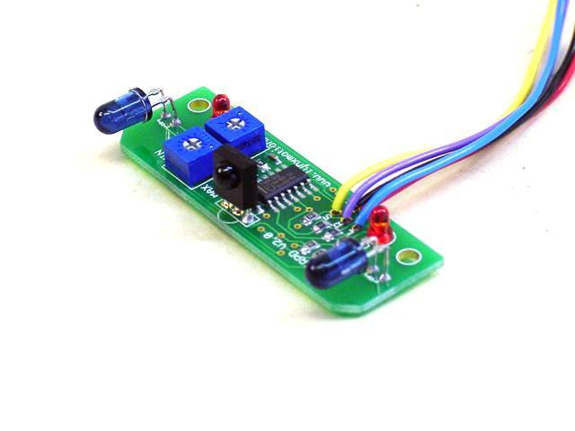
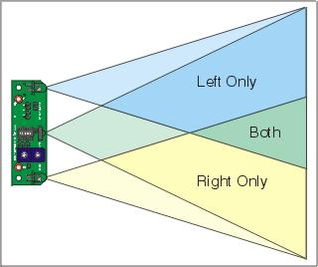
Infrared - Active
$30 from Lynxmotion
July 99 Encoder
Notes:
Picture of an active IR sensor system.

Slide 18
Active IR Sensor Specs
Sensor type = Reflective IR
IR detector = Panasonic PNA4602M
IR LED type = Narrow focus 10º
I/O required = 3 digital lines: 2 outputs, 1 input
Range = Approximately 4“ to 26"
Input voltage = 5vdc regulated @ 8mA
PC board size = 2.3" x .75"
Notes:
Specs for IR sensor system on previous slide.

Slide 19
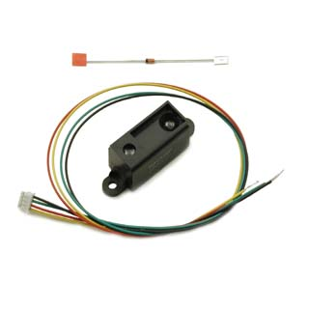
Linear Array IR Range Sensors
Sharp GP2Dxx (one of many)
~4 to 30cm Range
Fixed Range with Discrete Output
Analog or Digital Output
Easy to Use
Notes:
Self-contained linear array IR range sensor.

Slide 20
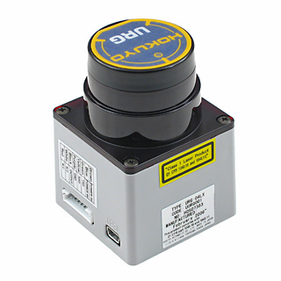
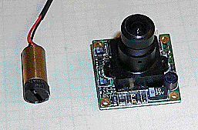
Laser Range Sensors
USB Interface
240º Field of View
0.36º Angular Resolution
10Hz Refresh Rate
20mm to 4m
$2695 (cool but pricey)
Also See:
Oct 2001 Encoder
Kenneth Maxon
Notes:
Very cool but pricey laser range finder and a much less expensive one featured in an Encoder article by Kenneth Maxon.

Slide 21
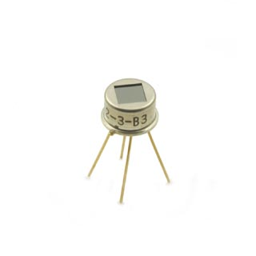
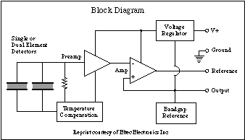
Passive IR – Pyro-Electric
$66 from Acroname
Dec 2000, Sept 2001 Encoder
The Model 442-3 IR-EYE is a Lithium Tantalate pyroelectric parallel opposed dual-element high-gain detector with complete integral analog signal processing.
Notes:
Pyro-electric sensors are designed primarily to “see fire”.

Slide 22
Sensors – Ultrasonic
Active
Emit pulses & listen for echos
Times round trip sound travel (~1ft/mS)
Reaches far fairly beyond robot (inches to 30-50’)
Relatively simple, not cheap, analog output
Directional; not everything reflects sound well
Passive (listens only)
Sensor listens for ultrasonic sounds
Electronics may translate frequency or modulation
Software may perform signal analysis (FFTs, etc.)
Notes:
For greater distances at affordable prices, ultrasonic range sensors are a good choice.

Slide 23
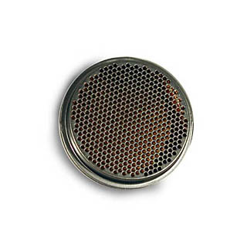
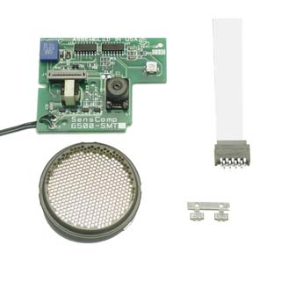
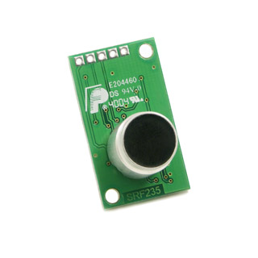
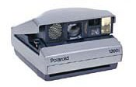
Ultrasonic - Active
$27
$49
$134
Visit http://www.acroname.com for more information about these & other products.
Search the web for “polaroid ultrasonic sensor”
Notes:
Picture of components and sub-systems for ultrasonic ranging systems.

Slide 24
Sensors – Ultrasonic (cont.)
Passive - Beacons & Sensors
Beacons listen: RF command to broadcast
Send light & sound pulses
Robot looks & listens for each beacon
Light pulse starts timer, sound pulse stops it
Robot knows location of each beacon
Compass on robot provides its orientation
Robot computes distance, measures bearing
Robot can then compute its location
(Speed of Light=1 ft/nS, Speed of Sound=1ft/mS)
Notes:
A location beacon concept.

Slide 25
Ultrasonic - Passive
Beacon3
Beacon1
Sound Pulse
Sound Pulse
Light Pulse
Light Pulse
Robot
Sound Pulse
BEACON
RF Receiver
IR Emitter
Ultrasonic Emitter
ROBOT
RF Transmitter
IR Receiver
Ultrasonic Receiver
Light Pulse
Beacon2
Notes:
Diagram of beacon system. It uses RF, IR, and ultrasonic systems.

Slide 26
Sensors – Sonic (Acoustic)
Active
Emit pulses & listen for echos
Times round trip sound travel (~1ft/mS)
Reaches far fairly beyond robot (30-50 ft)
Relatively simple, not cheap, analog output
Directional, not everything reflects sound
Noisy!!!!
Passive (sensor only)
Sensor listens to ambient sounds
Filters or scans selected frequencies
ADC measures conditioned signal amplitude
CPU performs signal analysis on what it hears
Notes:
How it works.

Slide 27
Sonic (Acoustic) - Passive
TI (Burr-Brown) UAF42 Universal Active Filter
http://focus.ti.com/lit/an/sbfa002/sbfa002.pdf
Notes:
Chips are available that can provide analog signal processing with programmable components.

Slide 28
Sensors – Resistance
Passive (sensor only)
Measures elec. resistance between objects
Measure sensor that varies resistance
Use absolute or differential readings
Other ideas?
Notes:
Measuring resistance directly usually requires some sort of electronic excitation. It is commonly done with a DMM or VOM. These devices excite probes with a low voltage and measure the current flow translating this into equivalent resistance via R=E/I.

Slide 29
Sensors – Capacitive
Passive
Really doesn’t work (Needs excitation)
Active (emitting)
Generate AC or DC voltage
Apply to external environment
Measure current to determine Resistance
Short range applications
Notes:
Measuring capacitance usually requires some sort of excitation. It is easier to measure something affected by capacitance than to measure it directly.

Slide 30
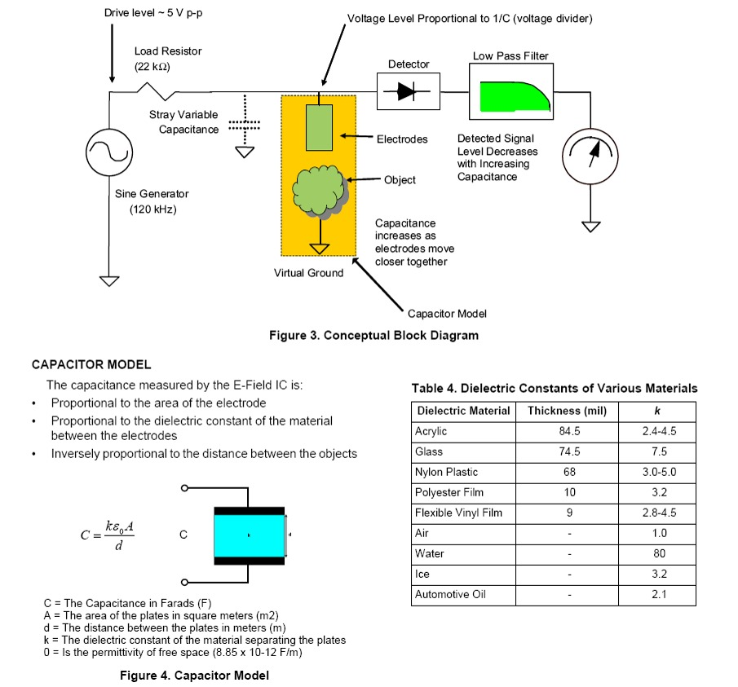
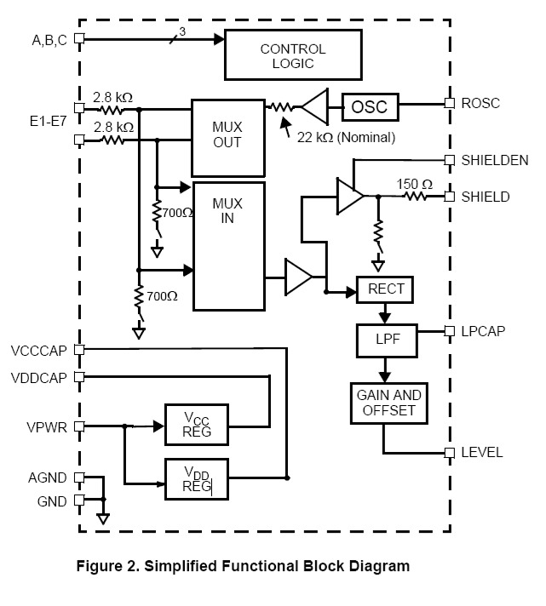
Sensors - Capacitive
Notes:
Here’s a circuit I mentioned a couple month ago that uses active excitation to measure the effects of external capacitances and provides a signal easily measured by a microcontroller.

Slide 31
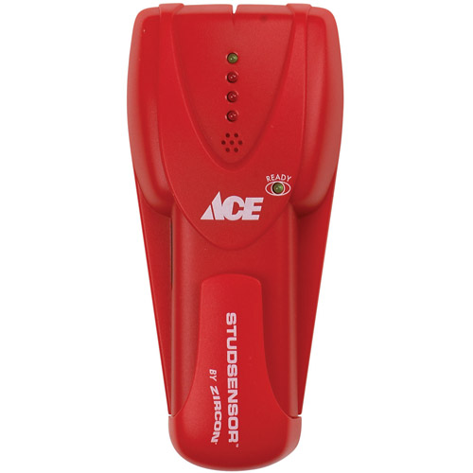
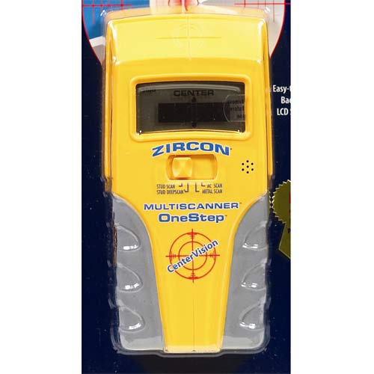
Sensors - Capacitive
Emit an electric field below the sensor.
Nulled to a known “void” wall area.
Detect capacitance difference due to underlying material density.
Notes:
These are typical capacitance-based sensors that detect the density variations inside walls to located studs, pipes, wires, etc. The effects of the material capacitance creates a detectable signal that is amplified and displayed on the units.

Slide 32
Sensors – Inductive
Passive
Really doesn’t work (Needs excitation)
Active (emitting)
Current flows through inductor
Magnetic field mostly ignores non-metals
Inductance changes with metallic proximity
Short range applications
Notes:
Measuring inductance usually requires some sort of excitation. It is easier to measure something affected by inductance than to measure it directly.

Slide 33
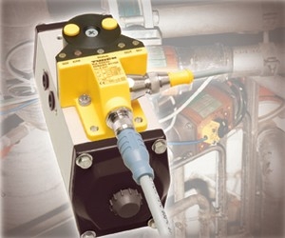
Sensors - Inductive
Passive
Really doesn’t work (Needs excitation)
Active (emitting)
Metals affect sensor
Current flows through inductor
Magnetic field mostly ignores non-metals
Inductance changes with metallic proximity
Short range applications (~cm or mm)
Notes:
Slide contents.

Slide 34
Sensors – Visual
Active (emitting)
Camera with field of view illumination
Looks for particular reflections
Filter removes non-significant light sources
Linear array senses single axis of motion
Passive (camera only)
Scans field of interest
Looks for objects, artifacts, features of interest
Processes digital data to simplified interpretation
Notes:
Cameras offer a whole new world of possibilities except that there is a lot of information in a visual field. Some products pre-process the video in the camera itself, providing view field coordinates of certain colored objects enabling a robot to track things in real time. One might also introduce an emitted element like a laser into the camera’s field of view and them calibrate for distance.

Slide 35
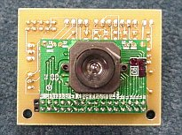
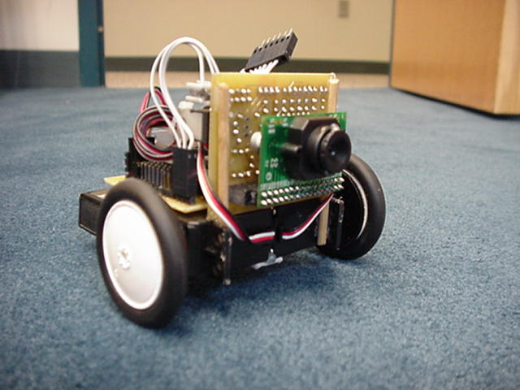
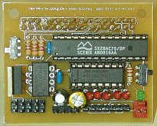
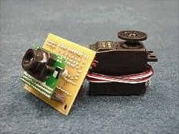
Sensors – Visual
CMUCam
Linear Optical Array
Notes:
Slide contents.

Slide 36
Sensors – Color
Active (emitting)
Selective field illumination (specific color(s))
Sensor filter removes extraneous light sources
Output can be analog (prop.) or digital (on/off)
Passive (sensors only)
Different sensors for different colors
Color filter removes extraneous light sources
Output can be analog (prop.) or digital (on/off)
Notes:
Color detection is an interesting problem that could be solved using a camera though there are some cool, low-cost ideas floating around as well.

Slide 37
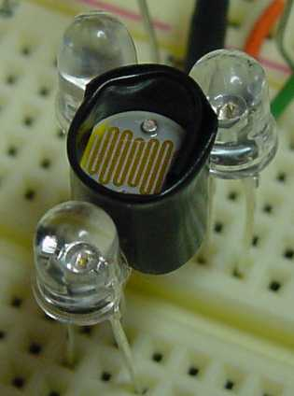
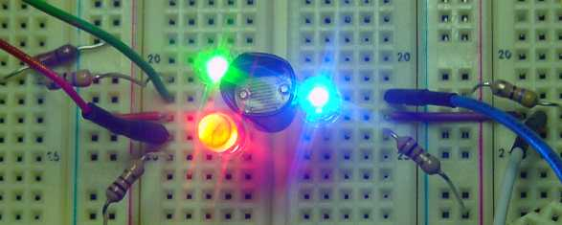
Sensors – Color
http://robotroom.com/ColorSensor.html
Notes:
This sensor emits read, green, and blue light in turn watching the photocell’s response to each color. With calibration the system can detect a surprising range of colors though greens and blues that are close together confuse it.

Slide 38
Sensors – Magnetic
Active (emitting)
Metal detectors
Follows metallic strips on or under the floor
Magnetometer
Magnetic Resonance Imaging (MRI)
Passive (sensors only)
Compass
Magnetic field sensor (→oscillating current)
Notes:
Magnetic sensors can operate actively and passively either detecting ambient magnetic fields or detecting the effects of nearby objects on an emitted field.

Slide 39
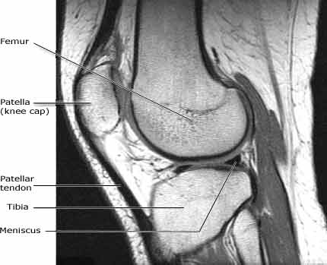
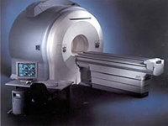
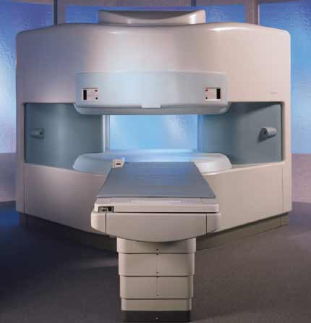
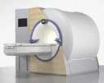
Sensors – Magnetic
From HowStuffWorks.com & RadiologyInfo.org
Notes:
This technology is used extensively in medicine to see inside the human body in amazing ways. Very powerful magnetic fields are required to generate these image details.

Slide 40
Sensors – Orientation
Rate Gyros
Output proportional to angular rotation speed
Integrate to get position
Differentiate to get acceleration
DC Accelerometer
Output proportional to sine of vertical angle
Notes:
Orientation is very important to balancing and flying robots. Knowing how it is moving (pitch, roll, yaw, speed of motion, etc.) is essential for a flying robot. A DC servo accelerometer can provide a sense of “down” or gravity and the robot’s angle of inclination relative to gravity.

Slide 41
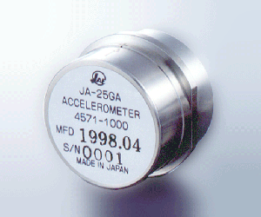
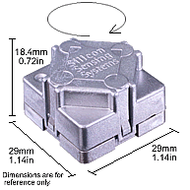
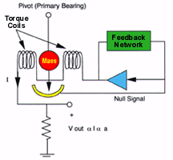
Sensors – Motion
Rate Gyro – Silicon Sensing Systems
Servo Accel – Sensorland.com
Notes:
Slide contents.

Slide 42
Sensors – Position/Location
Wheel Encoders
Relative position & motion
Integrate/Differentiate for other parameters
Global Positioning System
Absolute position/location on earth
Local differential error correction
Integrate/Differentiate for other parameters
Notes:
Position and location are also useful and necessary. The previous sensors’ data can integrated to compute some of this kind of information. Sensors that tell you where you are also come in the form of sophisticated global systems such as GPS. By using several of these sensory systems together a robot can determine much about its position, location, orientation, and motion.

Slide 43
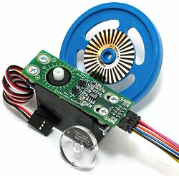
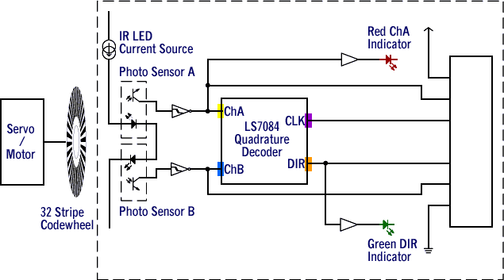
Wheel Encoders
Nubotics.com, $27
Jun 98, Oct 2000 Encoder
Notes:
Slide contents.

Slide 44
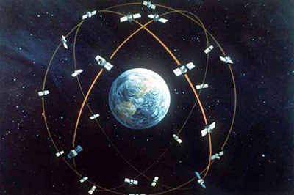
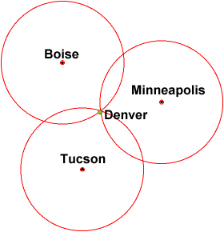
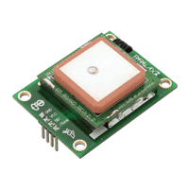
Sensors – Position/Location
Parallax.com
$80
Notes:
Slide contents.

Slide 45
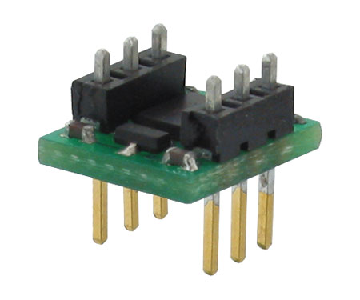
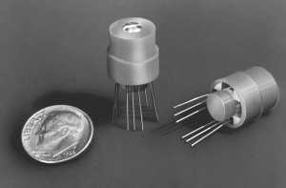
Sensors – Compass (Orientation)
Track bearing & distance to determine position
L: Parallax.com, $30
R: Dinsmoresensors.com, $13-$37
Notes:
Slide contents.

Slide 46
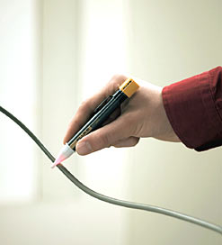
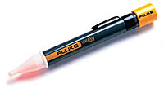
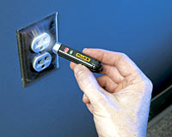
Sensors – Voltage
Passive – Senses electric field
Fluke Electric Field Sensors
$23
$25
$24
Notes:
Electric field sensors are cool because a robot could use them to locate a “feeding station” or to track a wire buried under the floor or ground. These sensors are relatively new and inexpensive. The small sensor in the middle can detect energized cords from nearly feet away!

Slide 47
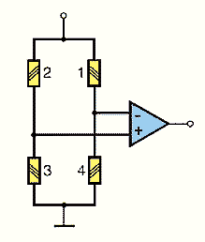
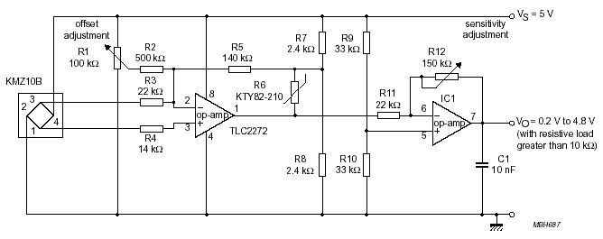
Sensors – Current
Series measurement with Hall Effect device
Current loop (coil), then amplified
Magnetoresistive (Wheatstone bridge)
Notes:
Current sensors are useful in monitoring power consumption of a robot or figuring out if it has run into something that might stall the drive motors. There are products available that use a Wheatstone bridge to sense current and produce a proportional analog signal.

Slide 48
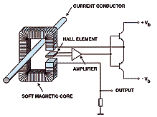
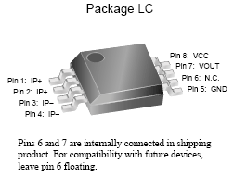
Sensors – Current
Notes:
Other sensors a set near or around a current-carrying conductor to measure the magnetic field produced by that current flow.

Slide 49
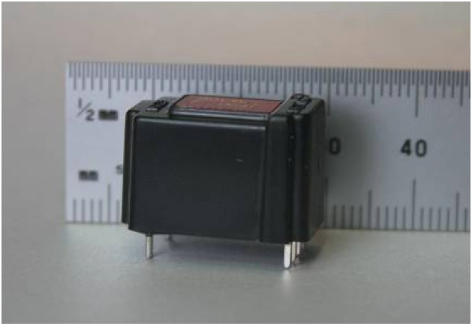
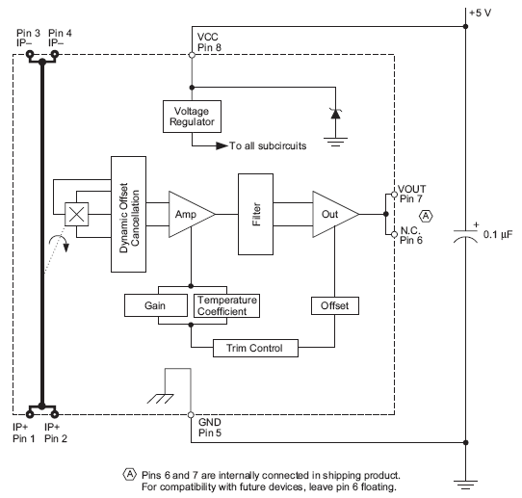
Sensors – Current
Notes:
Other sensors a set near or around a current-carrying conductor to measure the magnetic field produced by that current flow.

Slide 50
Sensors – Chemical
Passive (sensors only)
Active (optical emitter/photo sensor)
Notes:
Chemical sensors are generally passive though if one considers illuminating a chamber to detect airborne particulates, then they can also be considered active.

Slide 51
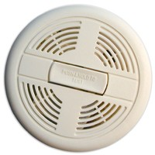
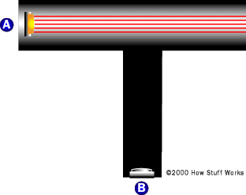
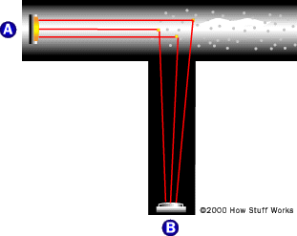
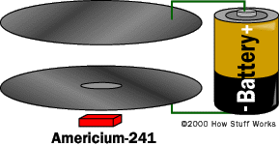
Sensors – Chemical
Smoke Detectors - Cheap, readily available, $5
Oxygen concentration sensors - CO, H₄S, CH_{4,} pricey
See HowStuffWorks.com
Notes:
Slide contents.

Slide 52
Sensors – Conclusion
Sensors provide a way of simulating “aliveness”
Sensors give robots environmental awareness
Sensors provide of means of human protection
Sensors help robot preserve itself
Sensors enable goal seeking
Sensors enable closed-loop interaction
Sensors make robots interesting
Sensors can make programming “challenging”
Notes:
Slide contents.

Slide 53
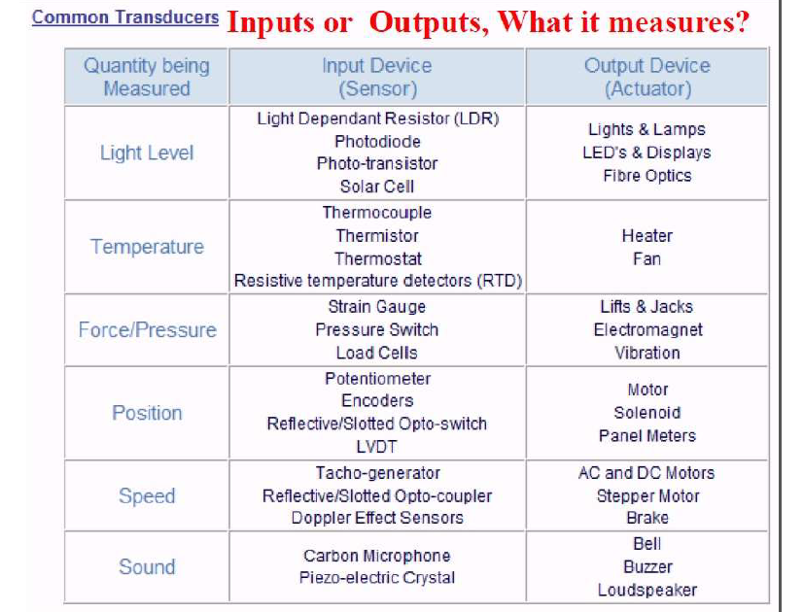

Slide 54
Smart Sensors
In traditional systems, each transducer is specified by its sensitivity, input and output signal ranges, offset, linearity, hysterisis, etc and always interest has been to improve some of the deficiencies.
When the traditional transducer, preferably miniaturized so as to be considered as a single device along with the IC chip, it has been treated as a smart sensor.
The micro miniaturization of the entire system, if implemented on a single chip it is considered as ‘smartness’ of the higher order.

Slide 55
Smart Sensors
Smart sensors may in short be defined as those sensors in which much of the signal conditioning is carried within the transducer housing and which will provide standardized output signals in digital form, and suited for transmission via a communication bus to the central control room.
They will linearize their own output , compensate for environmental changes, and include self calibration and diagnostic functions, both for themselves and for the systems to which they are applied.

Slide 56
Soft sensors
A soft sensor is a sensor that handles mathematical operations necessary to deliver the output signals in the desired dimensions, after effecting computation on the measured data obtained from other sensors.
Example: When a tank is getting filled with a liquid, liquid level is measured and from the level values, flow rate is to be calculated. The calculator here is the soft sensor.

Slide 57


Slide 58


Slide 59

General Architecture of Smart Sensor

Slide 60


Slide 61


Slide 62

Information Coding/Processing

Slide 63

Data Compensation

Slide 64
Top Smart Sensors -
Temperature Sensors
Proximity Sensor
Pressure Sensor
Gas & Smoke Sensor
Accelerometer Sensors
Level Sensors
Image Sensors
Motion Detection Sensors
Optical Sensors
Gyroscope Sensors

Slide 65

Smart Sensors (Cont..)

Slide 66

Smart Sensors (Cont..)

Slide 67

Smart Sensors (Cont..)

Slide 68

Smart Sensors (Cont..)

Slide 69

Smart Sensors (Cont..)

Slide 70

Smart Sensors (Cont..)

Slide 71

Smart Sensors (Cont..)

Slide 72

Smart Sensors (Cont..)

Slide 73

Smart Sensors (Cont..)

Slide 74

Smart Sensors (Cont..)

Slide 75

Advantage -

Slide 76

Disadvantages -

Slide 77



































Accelerometer
Gyro
Gas Sensor
Pendulum Resistive
Tilt Sensors
Metal Detector
Piezo Bend Sensor
Gieger-Muller
Radiation Sensor
Pyroelectric Detector
Resistive Bend Sensors
UV Detector
CDS Cell
Resistive Light Sensor
Digital Infrared Ranging
Pressure Switch
Miniature Polaroid Sensor
Limit Switch
Touch Switch
Mechanical Tilt Sensors
IR Pin
Diode
IR Sensor w/lens
Thyristor
Magnetic Sensor
Hall Effect
Magnetic Field
Sensors
Polaroid Sensor Board
IR Reflection
Sensor
IR Amplifier Sensor
Magnetic Reed Switch
IRDA Transceiver
Lite-On IR
Remote Receiver
Radio Shack
Remote Receiver
IR Modulator
Receiver
Solar Cell
Compass
Compass
Piezo Ultrasonic Transducers

Slide 78
References
D.V.S. Murthy, Transducers and Instrumentation, PHI,2013

Slide 79
Thank you
Queries?

